Slide 1
FACI-An app which detects fake currency Notes
Supervised by: Presented by:
SRIRAM KARTHICK- 311619104073
VARUN KUMAR -311619104079
IV year CSE B / MNMJEC

Slide 2
CONTENTS
Abstract
Literature survey
Base paper details
Existing system
Proposed system
System architecture
Modules
Reference paper

Slide 3
ABSTRACT
Fake notes in India are being flooded into the system. At present fake note recognition becomes the major issue for the researchers. The main focus of this standard paper currency identification system is on recognizing fake currencies. The currency identification system is a must and it is essential that it should be very accurate. The paper currency identification depends upon a number of steps, including edge detection, feature extraction, image segmentation, image acquisition, grayscale conversion, and comparison of images. In this paper, we have seen that different type of literature survey which describes different techniques of fake currency identification.
Fake Currency Detection is the biggest problem faced by many countries including India. Though Banks and other large organizations have installed Automatic machines to detect fake currency notes, it is really difficult for an average person to distinguish between the two.
Counterfeiting of money is as old as money itself, and is sufficiently prevalent throughout history that it has been called the world's second oldest profession. This has led to the increase of corruption in our country’s growth.
Some of the methods to detect fake currency are water marking, optically variable ink, security thread, latent image, techniques like counterfeit detection pen and using PYTHON OR MATLAB

Slide 4
Literature survey
In paper[1], Fake notes are increasing everywhere in this modern technology. At present fake note recognition become the major problem. The main aim is to recognise the fake notes from the original notes. The currency identification system should be necessary and it is essential. There are so many steps including in this process is edge detection, feature extraction, image segmentation, image acquisition, grayscale conversion, pre processing and comparison of images. In this paper, there are different types of literature survey which describes different techniques of identifying fake currency notes. This paper also proposes a review on Fake Currency identification techniques to detect counterfeit notes. By applying some efficient preprocessing and feature extraction techniques, there are chances to still improve the accuracy of currency identification system.
In paper [2], The extracted region of interest (ROI) can be used with Pattern Recognition and Neural Networks matching technique. First they acquire the image by simple flat scanner on fix dpi with a particular size, the pixels level is set to obtain image. Few filters are applied to extract denomination value of note. They use different pixel levels in different denomination notes. The Pattern Recognition and Neural Networks matcher technique is used to match or find currency value/denomination of paper currency

Slide 5
BASE PAPER DETAILS
Technology is growing very fast in these days. Similarly the banking sector is also improving day by day. Many researchers have been encouraged to develop robust and efficient automatic currency identification machine.
Automatic machine which can be used to detect banknotes are now widely used in dispensers of modern products like candies, soft drinks bottle to bus or railway tickets.
The technology of currency recognition system basically aims for identifying and extracting visible and invisible features of currency notes. Until now, many techniques have been proposed to identify the currency note. But the best way is to use the visible features of the note .

Slide 6
EXISTING SYSTEM
The existing system of this project used counterfeit pen to find the originality of note. The iodine is used to detect the fake note by reacting with the paper. The disadvantage of this system is it can easily counterfeited by removing the starch in paper.

Slide 7
PROPOSED SYSTEM
The system will work on two images, one is original image of the paper currency and other is the test image on which verification is to be performed. The proposed algorithm for the discussed paper currency verification system is presented as follows
A. Image of paper currency will be acquired by simple scanner in .jpg extension.
B. The image processing will be implemented on this image.
C. The various characteristics of the paper currency will be cropped and segmented.
D. After segmentation, the characteristics of the paper currency will be extracted.
E. The extracted characteristic of test image then undergoes classification.
F. On the basis of classification the result is generated. In the proposed method characteristics of paper currencies are employed that are used by people for differentiating different banknote denominations.

Slide 8
SYSTEM ARCHITECTURE
WEB SERVER
FRONTEND
CAMERA
WEB SERVICE
NODE JS
COMMUNICATION
WEB SERVICE PROTOCOL
KNN PROCESSING

Slide 9
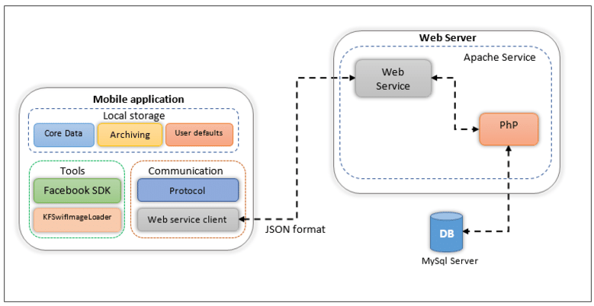
SYSTEM ARCHITECTURE
KNN Processing
API FORMAT

Slide 10
KNN TECHNIQUE
K nearest neighbour algorithm is very simple.
It works based on minimum distance from the query instance to the training samples to determine the K-nearest neighbours.
The data for KNN algorithm consist of several multivariate attributes name that will be used to classify images.
K nearest neighbours is a simple algorithm that stores all available cases and classifies new cases based on a similarity measure (e.g., distance functions). KNN has been used in statistical estimation and pattern recognition.
The KNN algorithm is a robust and versatile classifier that is often used as a benchmark for more complex classifiers such as Artificial Neural Networks (ANN) and Support Vector Machines (SVM).
Despite its simplicity, KNN can outperform more powerful classifiers and is used in a variety of applications such as economic forecasting, data compression and genetics. For example, KNN was leveraged of functional genomics for the assignment of genes based on their expression profiles.

Slide 11
METHODOLOGY
1. See through Register :
The small floral design printed both on the front (hollow)and back (filled up) of the note in the middle of the vertical band next to the Watermark has an accurate back to back registration. The design will appear as floral design when seen against the light.
2. Water marking :
The Mahatma Gandhi Series of banknotes contain the Mahatma Gandhi watermark with a light and shade effect and multidirectional lines in the watermark window.
3. Fluorescence :
Number panels of the notes are printed in fluorescent ink. The notes also have optical fibres. Both can be seen when the notes are exposed to ultra-violet lamp.
4. Security Thread :
The Rs.500 and Rs.100 notes have a security thread with similar visible features and inscription Bharat (in Hindi), and RBI. When held against the light, the security thread on Rs.1000, Rs.500 and Rs.100 can be seen as one continuous line. The Rs.5, Rs.10, Rs.20 and Rs.50 notes contain a readable, fully embedded windowed security thread with the inscription “Bharat” (in Hindi), and RBI. The security thread appears to the left of the Mahatma's portrait

Slide 12
5. Intaglio Printing :
The portrait of Mahatma Gandhi, the Reserve Bank seal, guarantee and promise clause, Ashoka Pillar Emblem on the left, RBI Governor's signature are printed in intaglio i.e. in raised prints, which can be felt by touch, in Rs.20, Rs.50, Rs.100, Rs.500 and Rs.1000 notes.
6. Latent image :
On the obverse side of Rs.1000, Rs.500, Rs.100, Rs.50 and Rs.20 notes, a vertical band on the right side of the Mahatma Gandhi’s portrait contains a latent image showing the respective denominational value in numeral. The latent image is visible only when the note is held horizontally at eye level.
7. Micro lettering :
This feature appears between the vertical band and Mahatma Gandhi portrait. It always contains the word “RBI” in Rs.5 and Rs.10. The notes of Rs.20 and above also contain the denominational value of the notes in micro letters. This feature can be seen well under a magnifying glass

Slide 13
MODULES
Pre-process
Segmentation
Acquisition
Comparison
Result

Slide 14
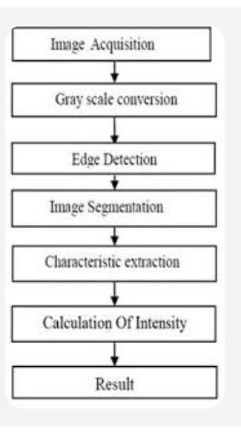
DATA FLOW DIAGRAM

Slide 15
REFERENCE PAPER
[1] Zahid Ahmed, Sabina Yasmin, Md Nahidul Islam, Raihan Uddin Ahmed “Image Processing Based Feature Extraction of Bangladesh Banknotes”
[2] Shital Mahajan & K.P.Rane. "A Survey on Counterfeit Paper Currency Recognition and Detection." in International Conference on Industrial Automation and Computing (ICIAC), April 2015.
[3] Prof. Renuka Nagpure, Shreya Shetty, Trupti Ghotkar, Chirayu Yadav, Suraj Kanojiya “Currency Recognition and Fake Note Detection” in International Journal of Innovative Research in Computer and Communication Engineering (IJIRCCE), March 2016.

